Slide 1

K.O.D. Inc

Slide 2


What is Quid
Quid is a mobile application that securely stores users passwords directly to their mobile device.

Slide 3

Motivation
Reuse of the same password
Strong Passwords
Numerous passwords
Database leakages
Annoying ads
Completely free

Slide 4
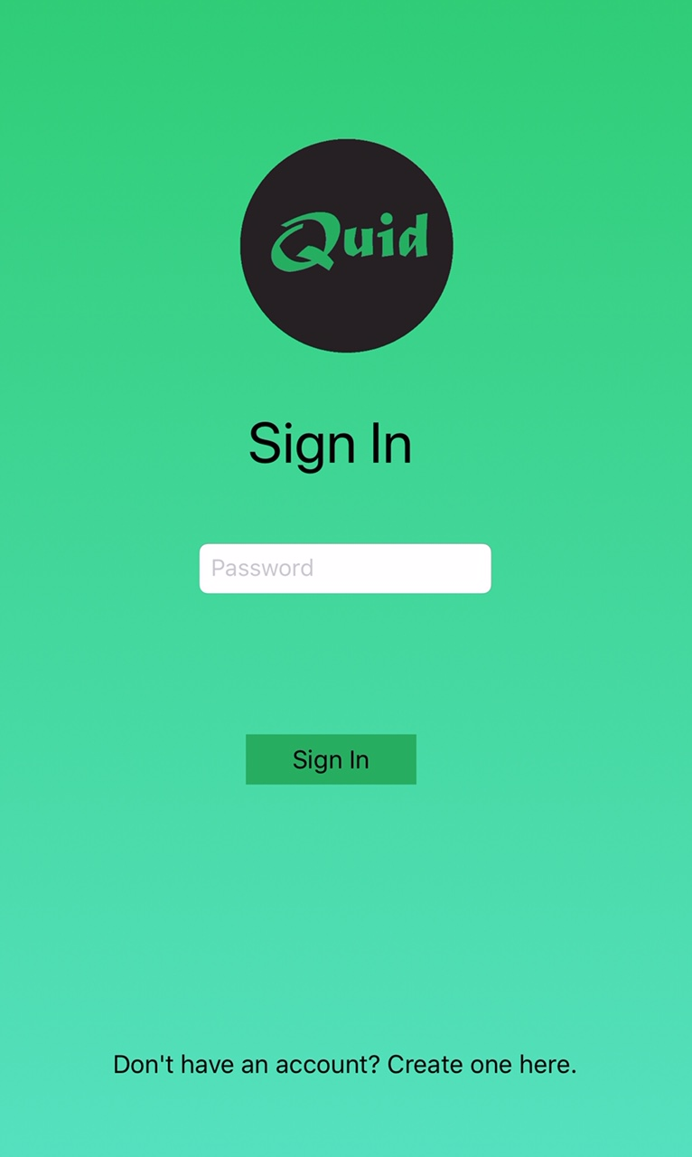
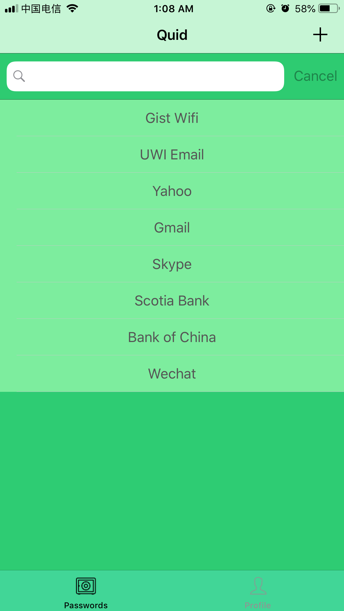
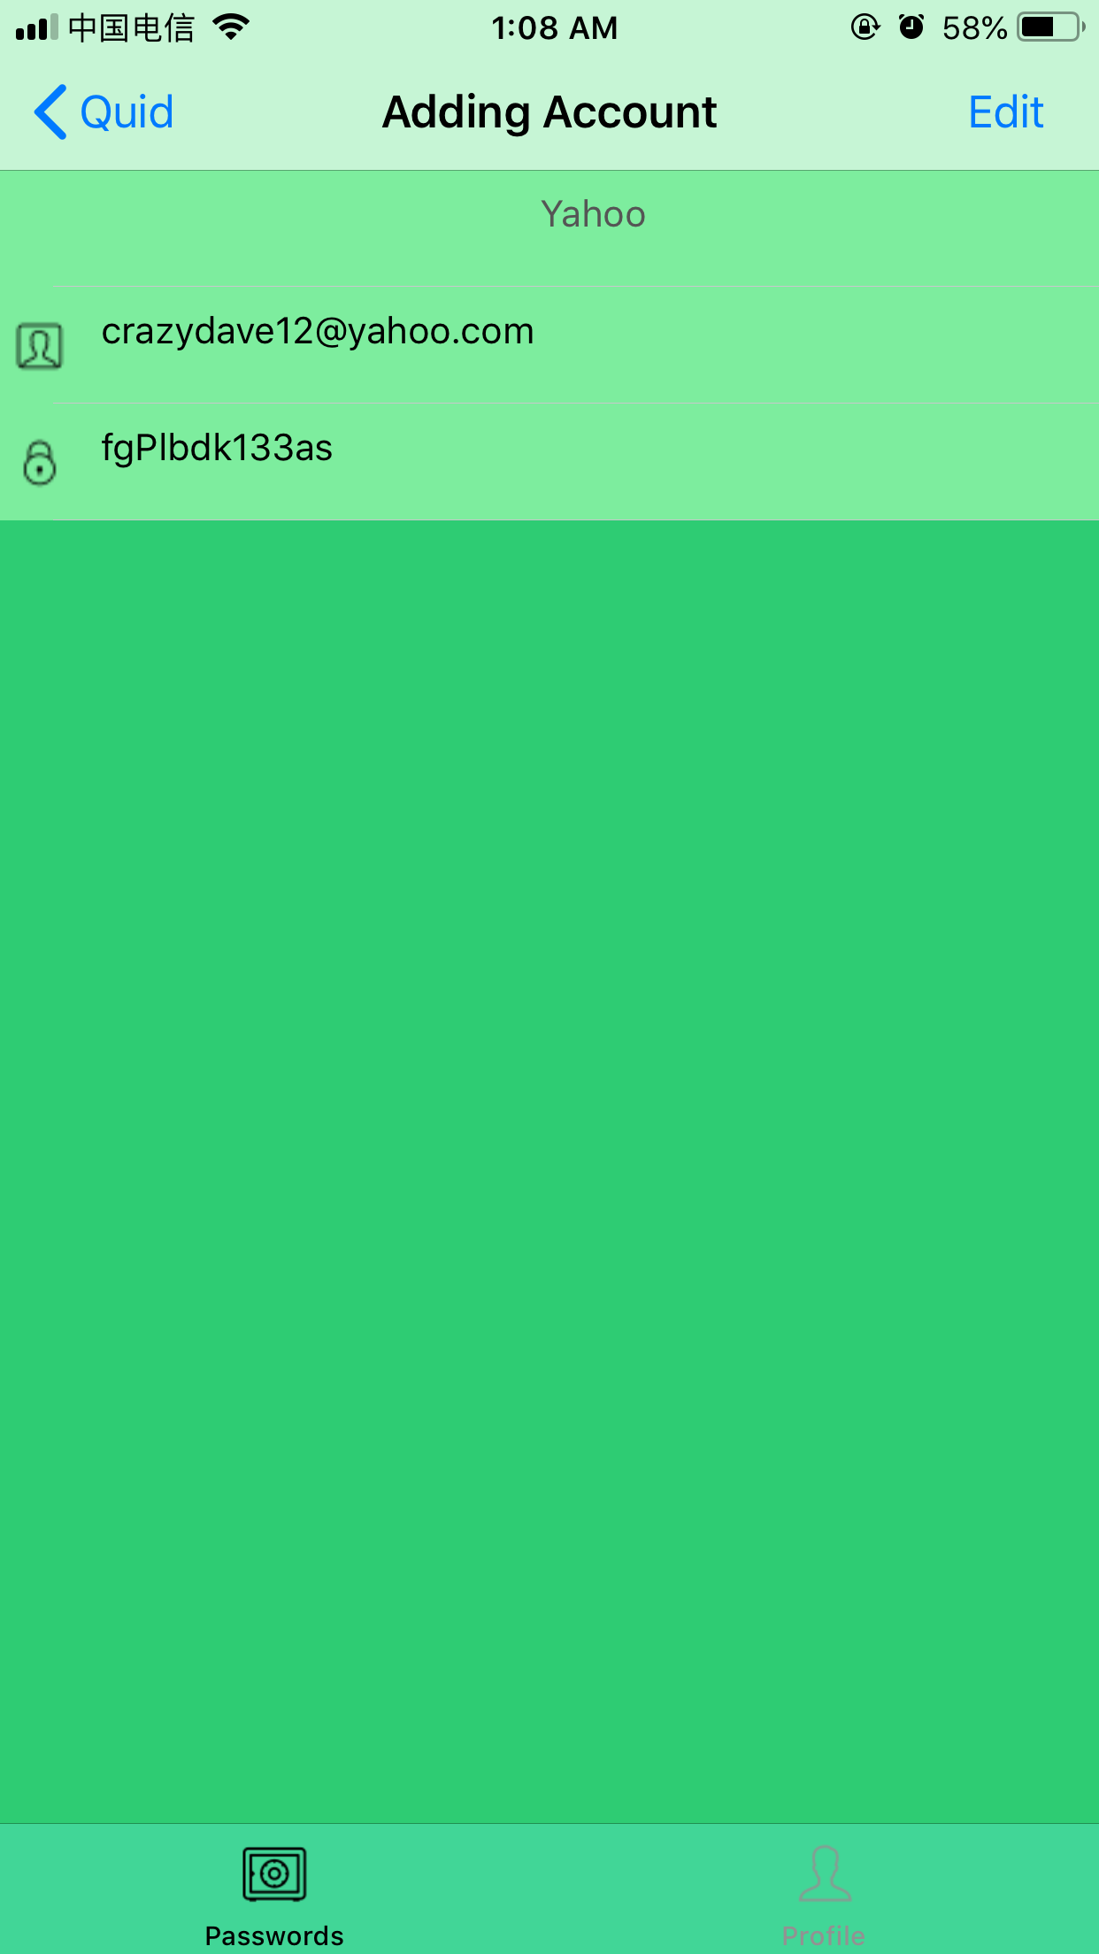
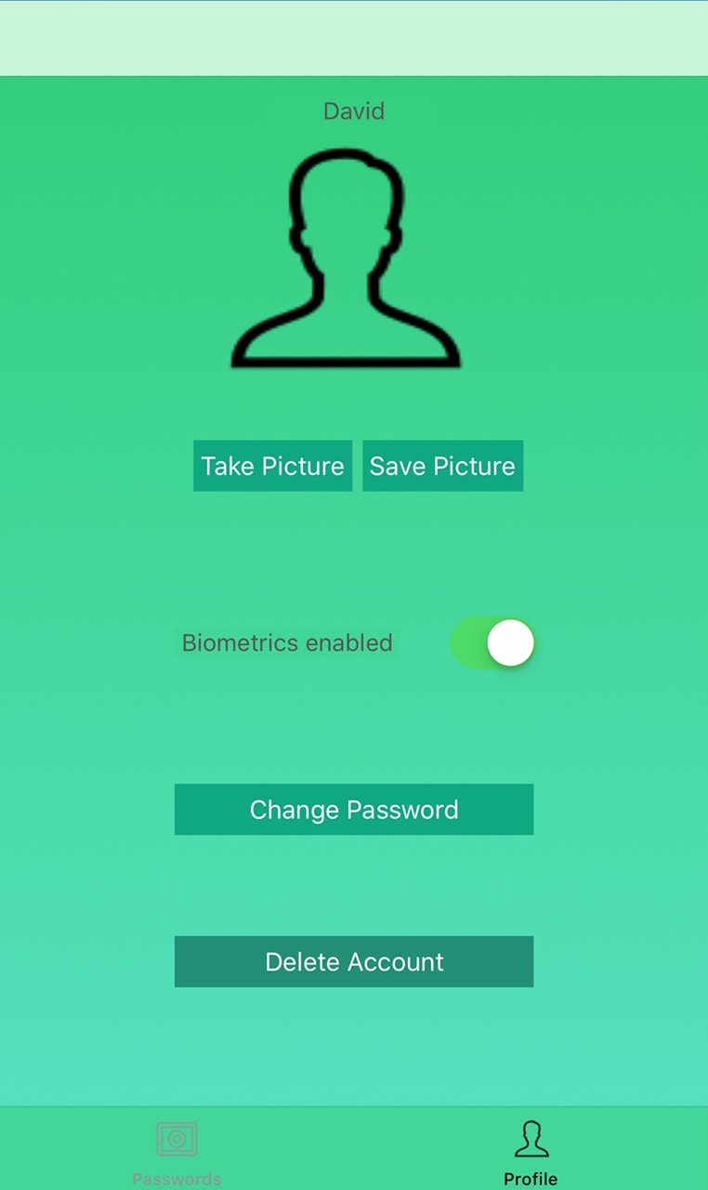
User Interface

Slide 5

AES 256
Symmetric keys
Robust
Commercial Usage

Slide 6
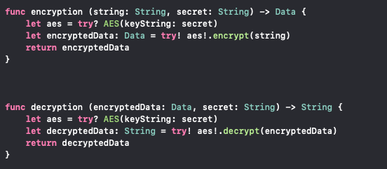
Code Implementation

Slide 7

Realm Database
Speed
Persistent engine
Ease of usage
Good Scalability

Slide 8
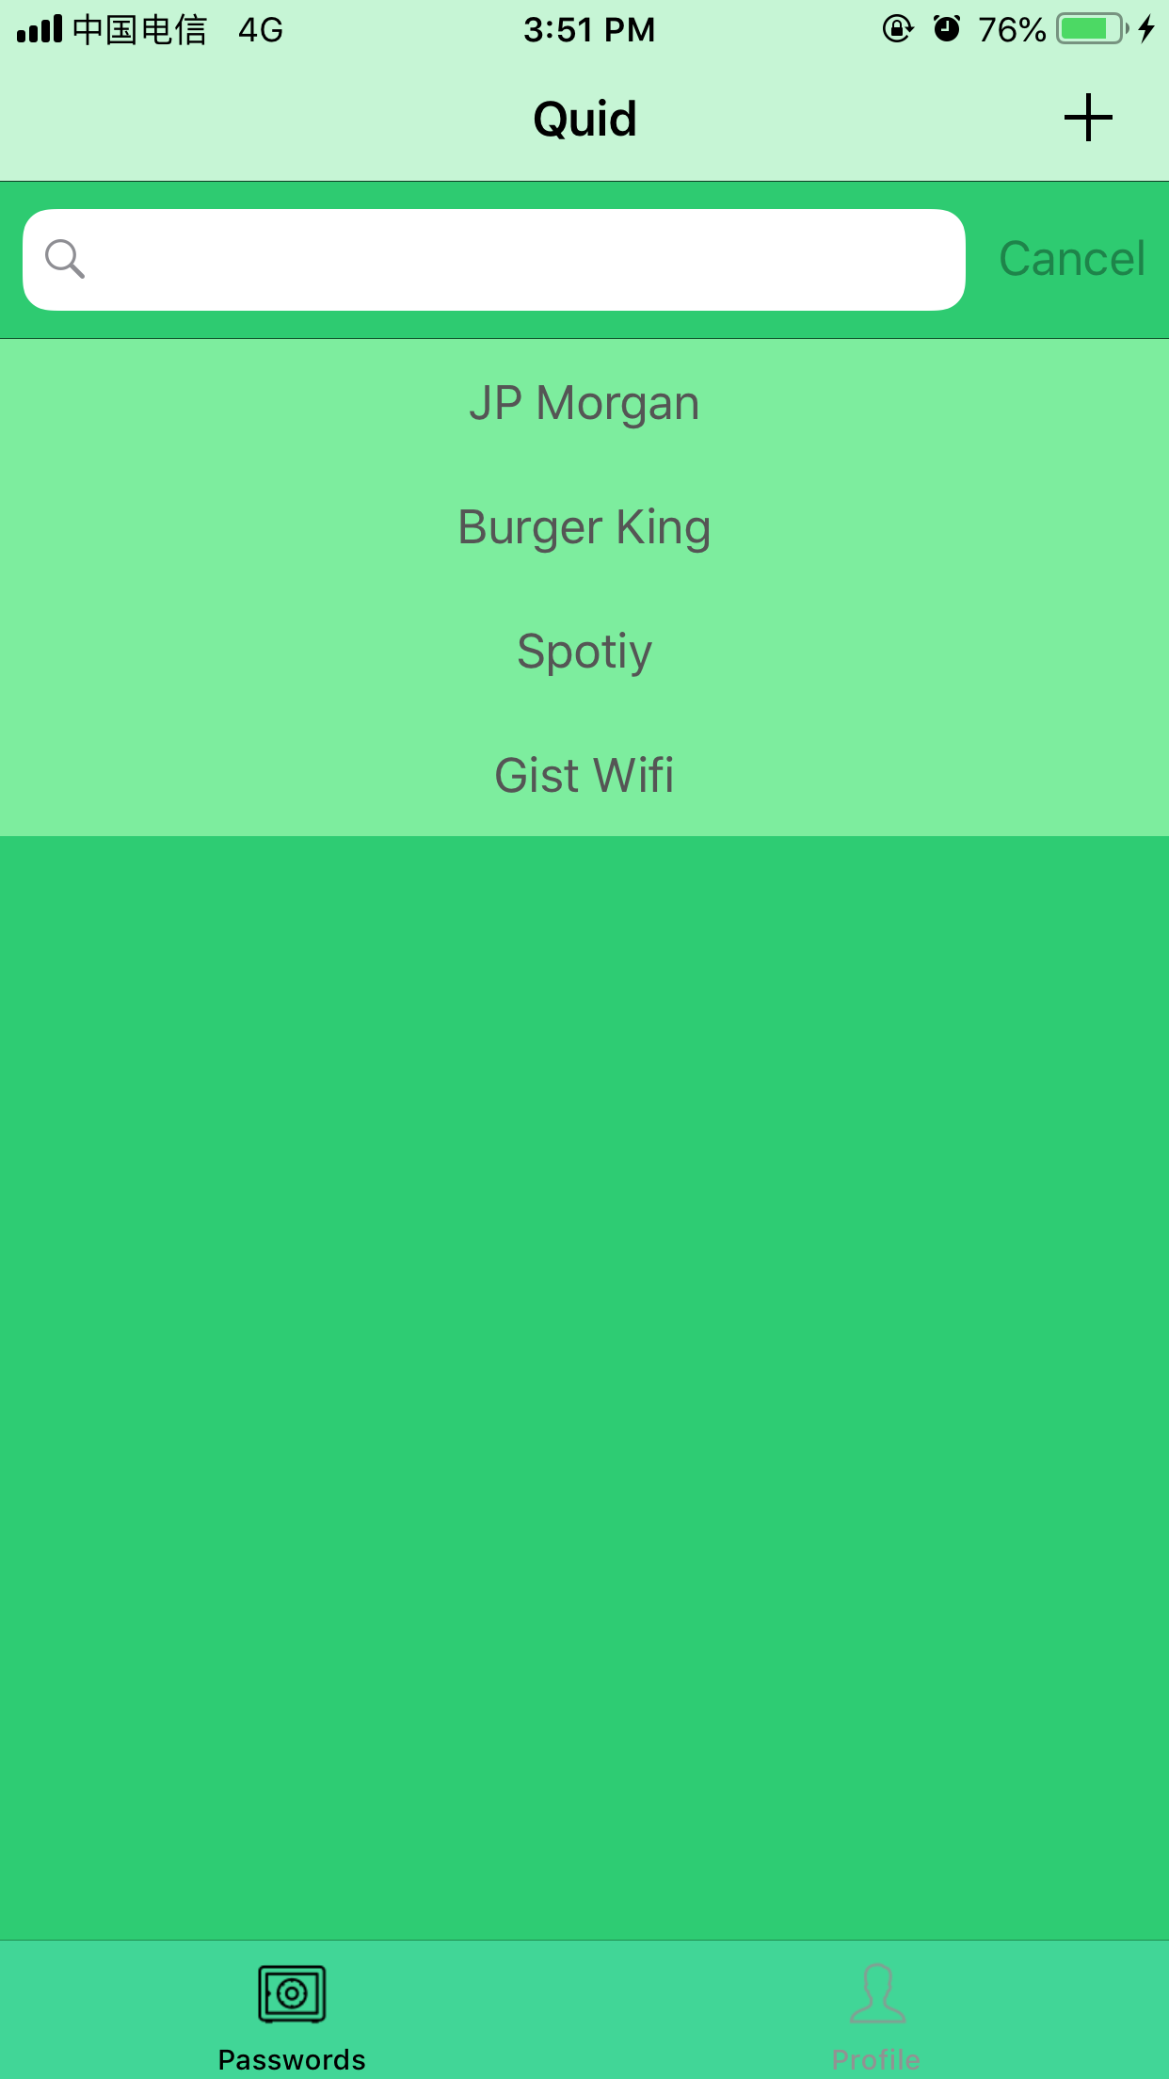
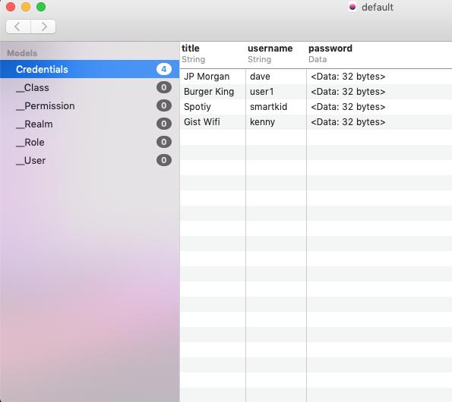
Realm Database

Slide 9
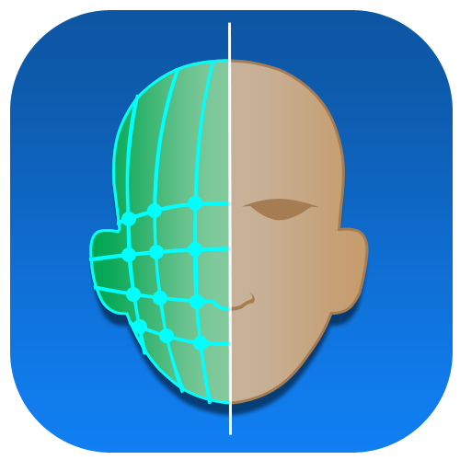
Biometrics
Convenience
Strong authentication
Difficult to fake

Slide 10
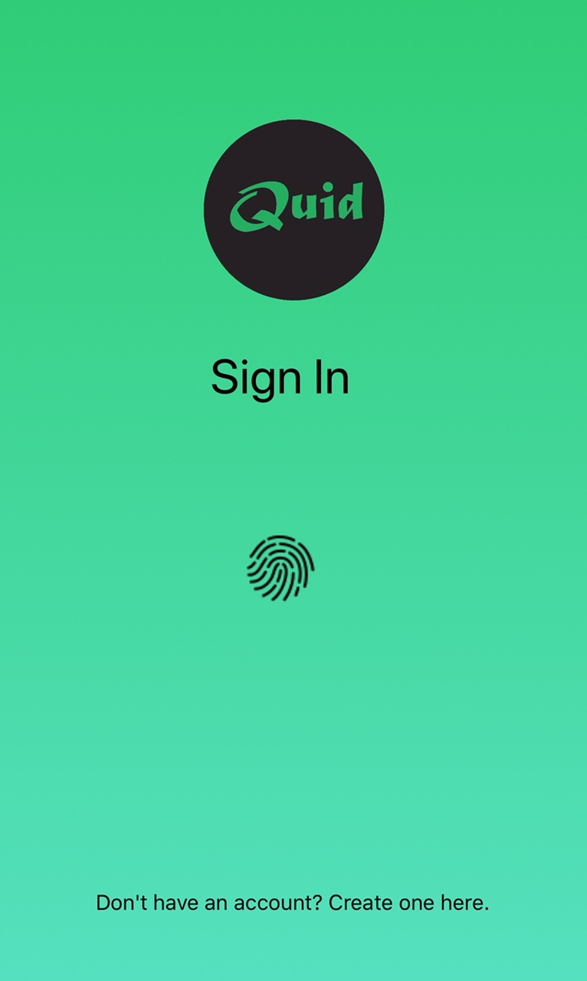
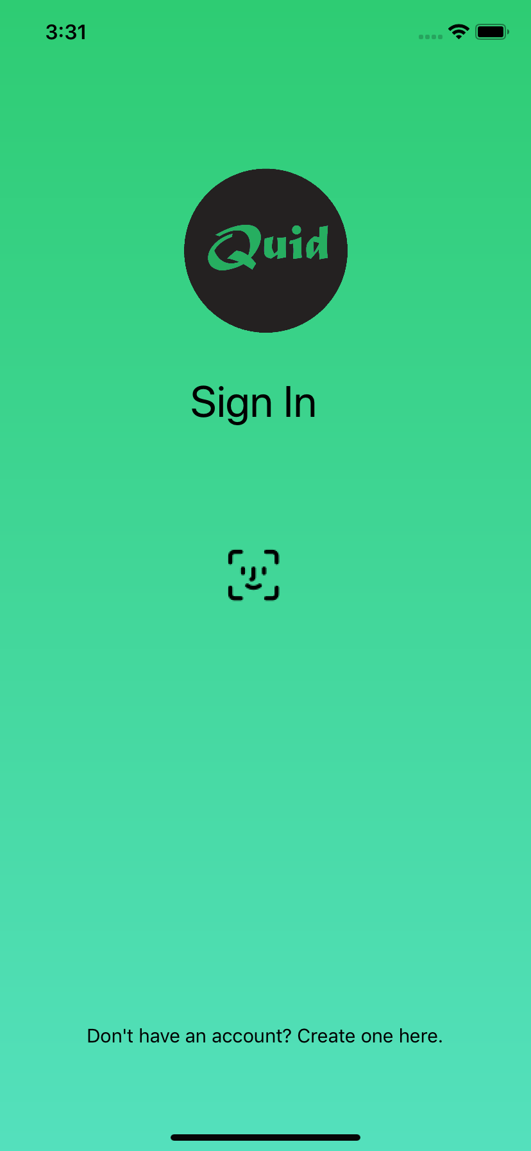
Biometrics
Iphone 6S plus
Iphone Xr

Slide 11
Demo

Slide 12

Future Improvements
Suggest strong passwords to the user
Auto login for websites and apps
Synchronization
Android version
Browser extension
Store credit card details
Website addresses

Slide 13
Thanks for Listening

